Slide 1
CEF at the Geopreservation Conference
Connecting Europe Facility
DIGIT
Directorate-General
for Informatics
DG Connect
Directorate-General for Communications Networks, Content and Technology
Notes:
Modular with big picture / political / implementation /
Validate slides by owners.
Service Offering Canvas Section

Slide 2
The Origins of the Single Market
“Economic integration will make war not only unthinkable but materially impossible”
BUSINESSES
CITIZENS
THE SINGLE MARKET
economies of scale
cheaper products
increased competitiveness
more choice
Robert Schuman
lower costs
more innovation

Slide 3


The Digital Single Market
Aims to ensure that citizens, businesses and public administrations can reap the benefits that digital has to offer.
A Top 10 Commission Priority
Source: Tallinn Declaration

Slide 4


The Tallinn Vision
Public Administrations must deliver high quality, user-centric digital public services for citizens and seamless cross-border public services for businesses.
Tallinn Declaration
Seven Principles
Digital-by-default
Once only
Trustworthiness and security
Openness and transparency
Interoperability by default
Horizontal enabling policy steps
User centricity

Slide 5


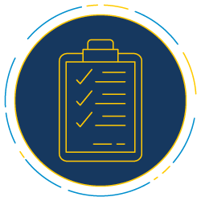
Digital transformation presents new challenges
Digital services are progressively having the same legal validity as as traditional paper process.
New EU-wide regulations are being designed to support the ongoing digital transformation, e.g.:
eIDAS (electronic Identification, Authentication and trust Services);
GDPR (General Data Protection Regulation);
eInvoicing Directive (electronic Invoicing in public procurement)
As a result, digital services must be trusted and work securely across borders (interoperability).
So that citizens and businesses benefit from the convenience of digital services and can make the most of the digital single market.

Slide 6



Submitting tax declarations online
Enrolling in a foreign university
Remotely opening a bank account
Setting up a business in another Member State
Authenticating an online payment
Bidding to an online call for tender
Digital Transformation powered by new EU-wide regulations will enable convenient cross-border online digital services.
… and many, many more.

Slide 7

How is the Commission helping PAs and businesses build digital services which comply to EU regulations?
Standards.
The Connecting Europe Facility’s mission is to support projects to use basic components, based on standards, that will ensure systems can communicate with each other.
We call these basic digital components
Building Blocks.

Slide 8

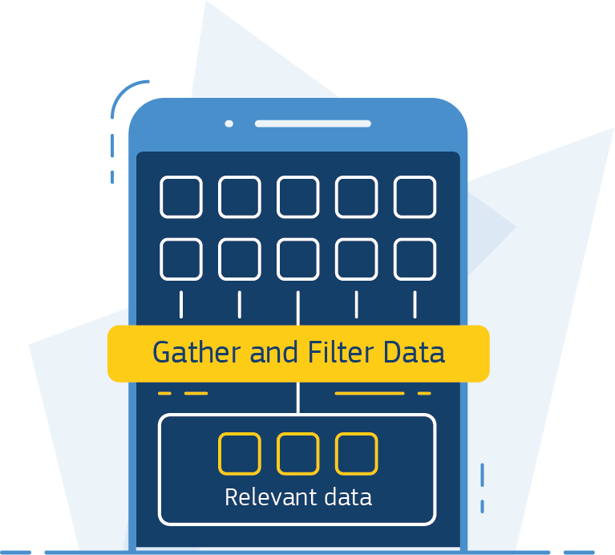
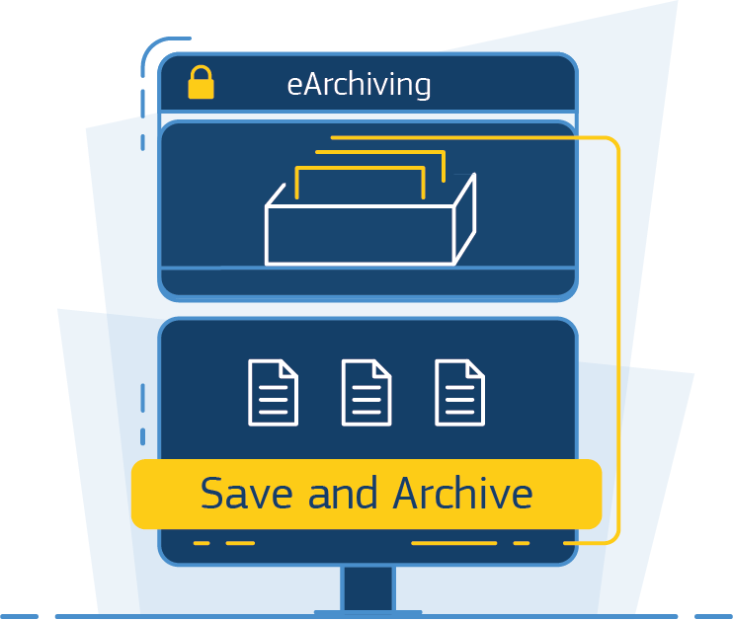
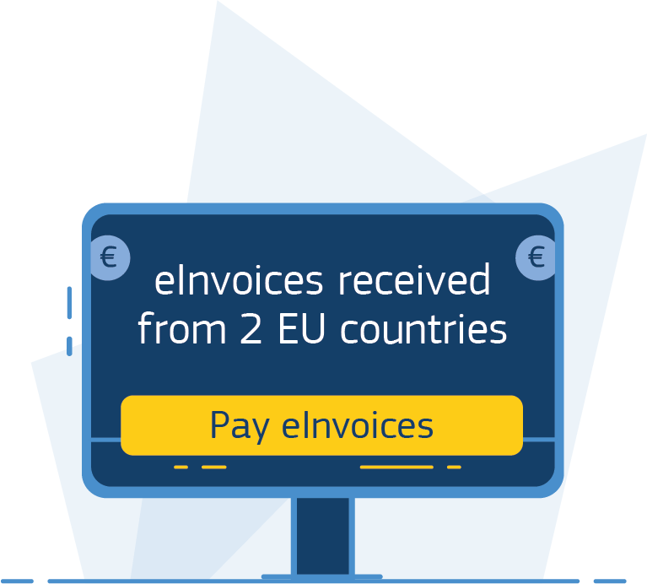
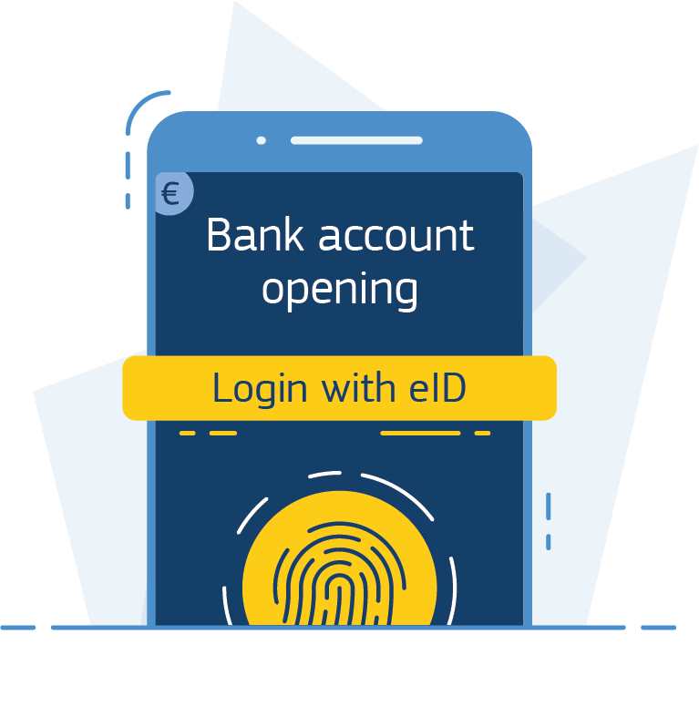
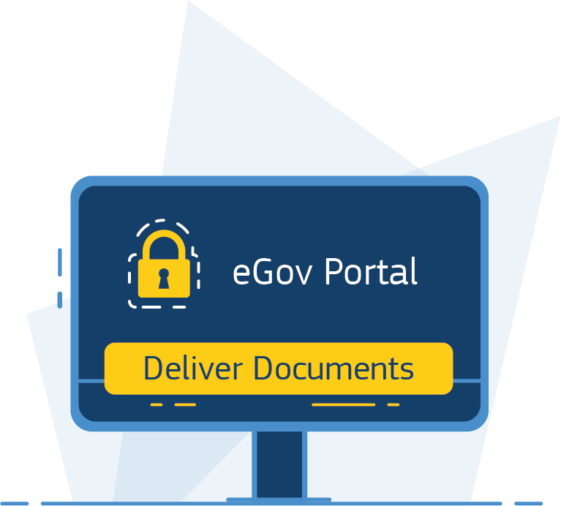
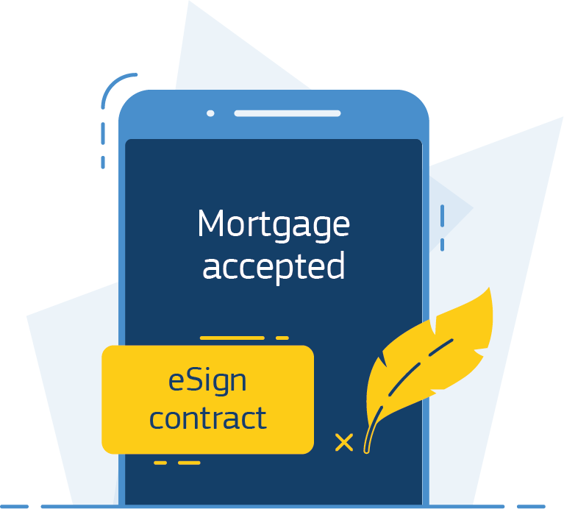
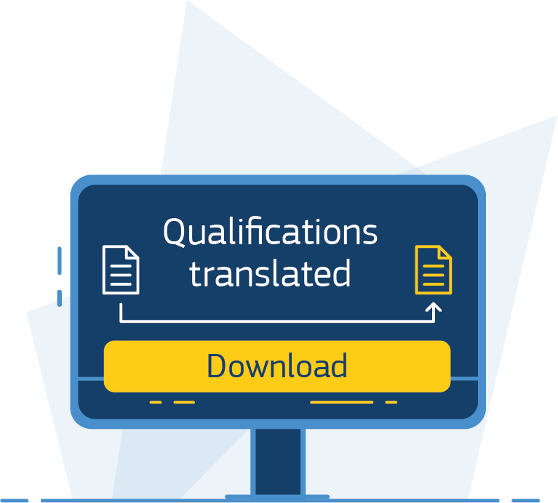
Data Economy
eInvoicing Directive
Big Data Test Infrastructure
Experiment with big data in a safe environment
Context Broker
Collect & share real-time data from multiple sources
eArchiving
Store and preserve digital information
eInvoicing
Send and receive electronic invoices
eIDAS enablers
eID
Securely identify European citizens
eDelivery
Exchange data and documents securely
eSignature
Create and verify legally recognised electronic signatures
eTranslation
Provide a multi-lingual public service

Slide 9
The CEF building blocks are funded by the Connecting Europe Facility
CEF Regulation
Defines how the Commission can finance support for the establishment of trans-European networks to reinforce an interconnected Europe.
TRANSPORT
€26.25bn
CEF
CEF
Digital
€970 M *
CEF Telecom Guidelines
The CEF Telecom guidelines cover the specific objectives and priorities as well as eligibility criteria for funding of broadband networks and Digital Service Infrastructures (DSIs).
TELECOM
ENERGY
€5.85bn
Broadband
€170 M
CEF Work Programmes
Translates the CEF Telecom Guidelines in general objectives and actions planned on a yearly basis.
* - 100 M Juncker Package

Slide 10
Free Services
How does CEF support projects to use the building blocks?
Training
sessions
In two ways:
One, it provides free services to help you implement them in your system. There are a range of services across the building blocks but services typically include training, sample software, testing services.
Sample
software
Testing services

Slide 11

Funding opportunities
For implementing the building blocks
How does CEF support projects to use the building blocks?
Call 1 14 February – 14 May 2019 | Indicative budget
Automated Translation | € 4M
eID & eSignature | € 5M
eDelivery | € 1M
eInvoicing | € 6.2M
Europeana | € 2M
EU Student eCard | € 1M
In two ways:
One, it provides free services to help you implement them in your system. There are a range of services across the building blocks but services typically include training, sample software, testing services.
Two, CEF provides grant funding. You can apply for grant funding to pay for the implementation of a building block in you system. More information on how you can apply, grant winners and on-going projects is available via INEA’s website.
Call 2 4 July – 14 November 2019 | Indicative budget
Public open data | € 5M
Cybersecurity | € 10M
eProcurement | € 3M
eHealth | € 5M
European eJustice | € 3M
European Platform on Skills and Jobs | € 1M
Visit INEA Website
Notes:
Make the CTA more clear. And perhaps expand the info to indicate what kind of information you will find there.
Perhaps show the big winners and the amounts they have received.

Slide 12
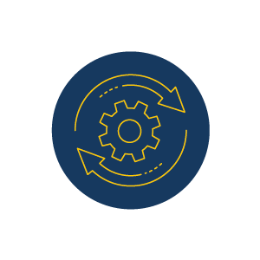
Co-develop and partner
With other parties
How to use a building block?
Build, buy or reuse the building blocks by your own.
Co-develop the solution or partner with other parties.
Build
Buy
Reuse
Build
The solution from scratch based on a European standard
Buy
A compliant solution from the market
Reuse
A sample software available on CEF website
European Standards

Slide 13






CEF is a funding instrument
That contributes to the completion of the European Digital Single Market
I
CEF funds Commission projects to digitise key sectors
Justice, home affairs and
citizens' rights
Science and
Technology
Business
Employment and
Social Rights
eJustice Portal
ODR
Open Data
BRIS
EESSI
The CEF Building Blocks across sectors
II
CEF provides grants to participate in projects.
Typically 'deployment' projects at national level (up to 75% of eligible cost)

Slide 14

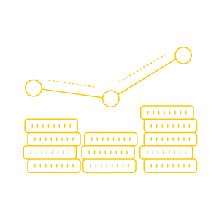


How many projects have used the building block?
Connected Europe
Vision
Great experience for citizens and businesses
Growing potential cases are bringing us closer to fulfilling the dream.
120
projects
Building a data-economy
Promoting cross-border interoperability
View Dashboard
Notes:
Add an additional success story slide

Slide 15
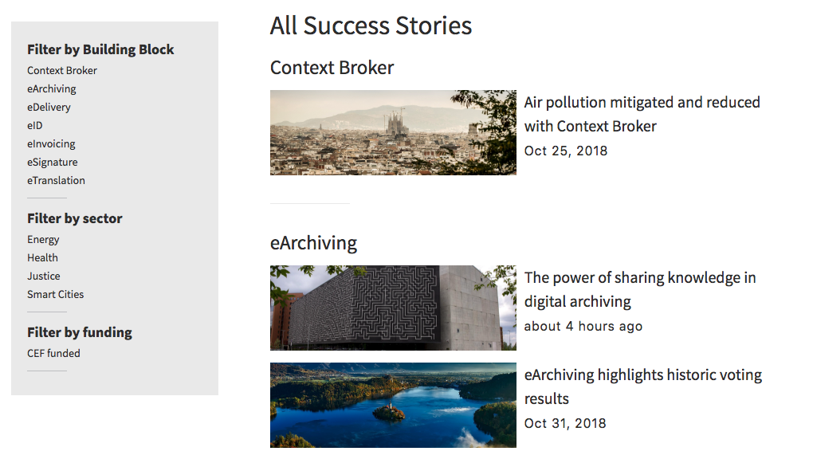
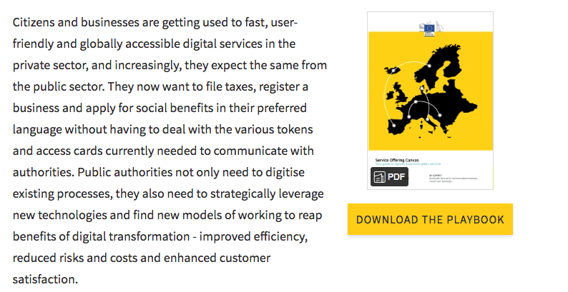
Success Stories
Our success stories provide insights into how projects have implemented the building blocks.
Read the Success Stories
Our Playbook
Learn how the CEF Programme uses the Service Offering Canvas to setup and operate the building blocks.
See the Playbook

Slide 16

<Domain Specific Slide>
[…]
Domain Specific Benefits
Add details to frame the building blocks in a domain specific context

Slide 17
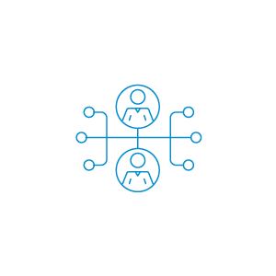

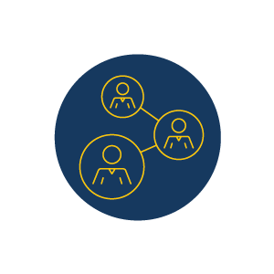


Main Benefits
How do we support you?
1
The building blocks are mature, ready to deploy solutions that will save projects time and money.
1
Apply for grant funding to pay for the implementation of a building block
2
The building blocks are based on open European standards so you avoid vendor lock-in.
2
The CEF Digital website has details of a a range of services across to support your implementation
3
They help public administrations connect to collaborate to deliver a great European experience for citizens and businesses.
3
Our service desk is available for you to provide answers to any questions you may have

Slide 18

Join us, we’re Connecting Europe!
The vision is to deliver user-centric digital public services for citizens and seamless cross-border public services for businesses.
        Public administrations must exchange data securely across borders in order to collaborate effectively and deliver a great experience to citizens and businesses.
        Projects using the building blocks are supporting the digital transformation of Europe by implementing eIDAS and contributing to the digital single market.

Slide 19

Meet
Big Data Test Infrastructure
Experiment and discover new ways to unleash the power of big data.

Slide 20






Is BDTI for me?
Yes, if you need to experiment with big data in a safe environment.
What we can help you achieve
Avoid setting up and maintaining a complex experimental environment
Gather knowledge, insight and value from your data
Develop pilot projects on big data in a virtual environment
Experiment with and create quick prototypes to verify and test data hypotheses or data visualizations

Slide 21
Main Benefits
How do we support you?
1
Access to a ready to use testing environment for your analytics experiments
1
Various data sources, software tools and big data techniques
2
The possibility to share and re-use data across policy domains and organizations
2
Advice and ongoing onboarding support from the CEF BDTI Team
3
Have access to best practices on big data
3
Knowledge base that provides insights to the platform and big data techniques

Slide 22

Supporting smart education with BDTI.
The challenge
Technology helps provide better use of information, higher support for life-long learning for all citizens and stakeholders by using education smart services that are flexible and intelligent. Smart education applications will engage people in active learning environments that allow them to adapt to the rapid changes of society and the environment.
Using big data in this context helps create a knowledge-based society, which will enhance competitiveness. Big data in education is generated mainly by collecting data on people (e.g. students, teachers, parents, administrator), infrastructures (e.g. schools, libraries, computing facilities, educational locations, museums, universities), and information (e.g. courses, books, exams, grades, economic surveys, assessments, reports, ect.). This data can create a useful resource for analysis and extracting useful trends, models and using them to offer better and more enhanced education.
The opportunity
BDTI provides a series of solutions that will help public educational organisations analyse and process correctly their data. BDTI supports the different elements of data processing, from data collection to data ingestion, transformation, analysis, exploration and visualisation. The test infrastructure allows users to request a virtual testing environment which provides a pre-configured and ready to use sandbox for analytics experiments. This will permit educational organisation to launch pilot projects on big data and data analytics allowing them to verify and test data hypotheses, methodologies or data visualisations. Once the pilot is completed, the institutions has the choice of publishing their data and sharing it with other parties through our data catalogue and data exchange APIs. BDTI can be used to support public educational organisations to personalise learning, create communities of practice or to observe educational shortages that will enhance study curriculums.

Slide 23
Meet
Context Broker
Make data-driven decisions in real time, at the right time

Slide 24
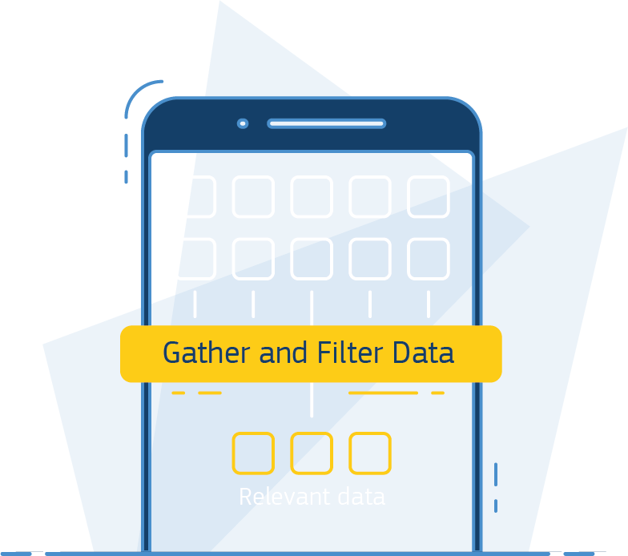
Is Context Broker for me?
Yes, if you need to collect data from multiple sources to gain deeper insights
What we can help you achieve
Assemble and manage contextualised information to and from different systems
Share context information with others to improve processes across the whole value chain
Make smart, data-based decisions in real time
Develop new innovative services based on shared data

Slide 25
Main Benefits
How do we support you?
1
Smarter decisions faster by leveraging broad-based, real-time context data
1
A set of standards and sample software with clear documentation
2
Standards-based ecosystems exploiting the same data, ensuring scalability
2
Connectivity and conformance testing services in sandbox
3
Faster time-to-market thanks to specifications and reference implementations
3
Support through our service desk and online community

Slide 26

Air pollution mitigated and reduced with Context Broker
The challenge
Cities collect large data sets from traffic, air pollution, public transport and citizen behavior data. However, how can the collected data be contextualized to help cities make better decisions? And to understand processes, see patterns and provide solutions before problems escalate?
Take for example pollution as an example. Air pollution forms a serious public health risk in urban environments. Many European cities are confronted with increasing air pollution and associated health problems. Barcelona, the second most populous city of Spain, is one of them. Learn how Context Broker helped Barcelona address this challenge.
The solution
Context Broker enabled the city of Barcelona to find an air pollution solution that would provide real time pollution data. This helped the city to find and understand the pollution sources better, and to tackle the pollution issue.
Context Broker centralises and provides context to data coming from a wide variety of sources, such as air pollution data. Providing data context helps public administrations make informed decisions with real time data that is already filtered, organised and labelled. In other words, it puts data into perspective. This helps to make data-driven decisions in real time, at the right time.
Contextualize your data and make smart, data based, decision in real time with Context Broker.
Read the story

Slide 27
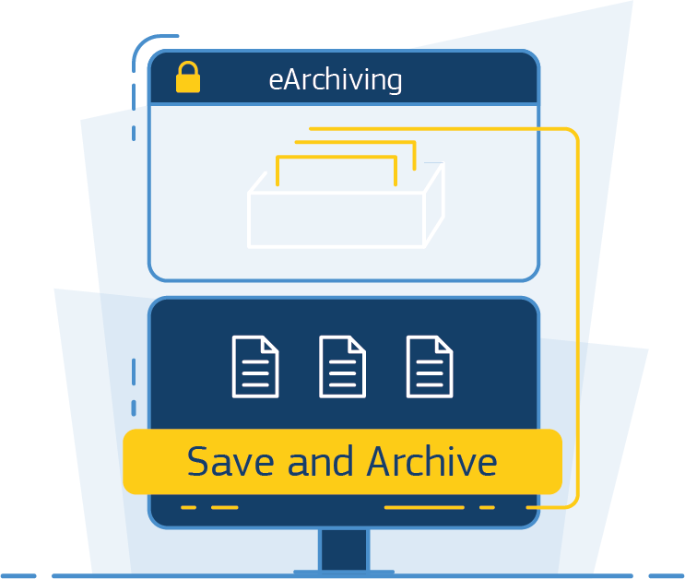
Meet
eArchiving
Store and preserve digital information cost-efficiently over the long term

Slide 28
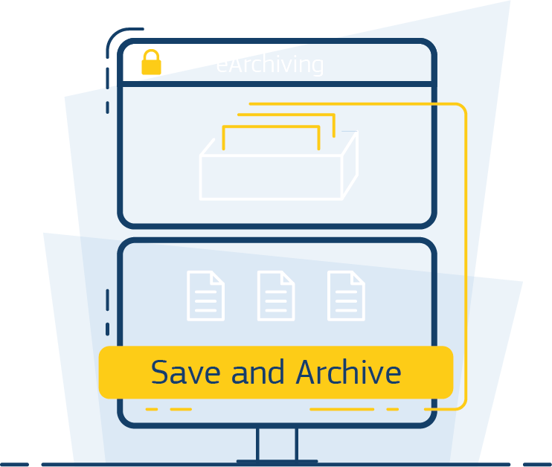
Is eArchiving for me?
Yes, if you need to guarantee access to your information in the future.
What we can help you achieve
Transfering information assets to repositories and between generations of technology
Comply with specifications and standards (OAIS, E-ARK, METS)
Long term integrity and authenticity of your data
Preserve and access data over extended periods of time

Slide 29
Main Benefits
How do we support you?
1
High-level security ensured by standards
1
A set of standards and sample software
2
Interoperability to package and transmit archival data between entities
2
Outreach and awarenss of digital preservation and archival information systems
3
Scalable digital archival systems from small to large
3
Consultancy and training in digital preservation risks and their mitigation
Notes:
Support through our service desk and online community

Slide 30

Standardising digital archiving in Europe with eArchiving
The challenge
Archives are a national treasure. They protect national documents for decades, even centuries and require careful archiving. Today, this archiving process is not always digitally yet. Complexity, cost and security concerns occupy, for example, national archives looking for digital solutions.
Take for example the Danish National Archives. It hosts more than 5,1000 databases in their inventory and processes more than 220 databases annually, equaling to 22 terabytes of data in 2017 alone.
Facing different European standards and specifications for digital archiving, the Danish National Archive looked for a pan-European solution at, preferably, low cost and high quality. eArchiving was the solution.
The solution
eArchiving facilitated the Danish National Archive digital transformation project with a universal set of standards and specifications for transmitting, describing and preserving digital data.
eArchiving helps to protect and maintain nation’s digital information, making it easier to access it anywhere at anytime. eArchiving helps public and private sector organisations to meet legal archiving obligations cost-effectively with the least amount of legwork. This helps to describe, transmit and preserve data based on international standards to future proof archiving solutions for the long run.
Read the story

Slide 31
Meet
eDelivery
Exchange data and documents securely and reliably

Slide 32
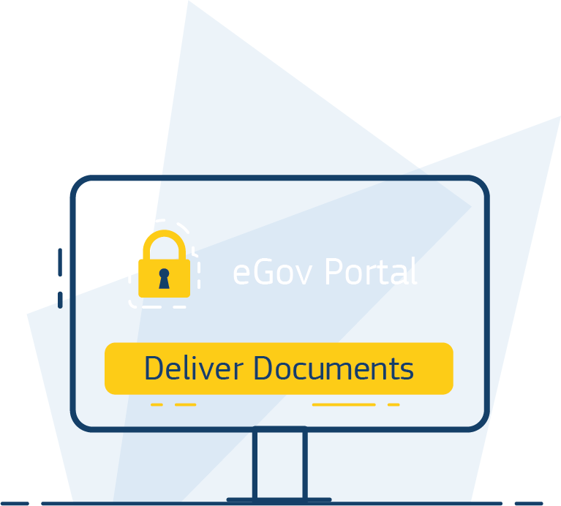
Is eDelivery for me?
Yes, if you want to exchange documents and data with the confidence of registered delivery services.
What we can help you achieve
Exchange electronic data and documents with public administrations, businesses and citizens
Set up a network based on technical specifications supported by the market
Create a secure network across borders
Implement the AS4 messaging protocol developed by OASIS

Slide 33
Main Benefits
How do we support you?
1
Interoperability to enable a variety of organisations to exchange data and documents
1
A set of specifications and sample software with clear documentation
2
Security, legal assurance and accountability promoting trust, transparency and confidence
2
Services to test deployment and configuration of AS4 Access Point
3
Scalability and performance regardless of the number of participants or messages exchanged
3
Support through our service desk and online community

Slide 34
Council of the EU’s information platform with Member States with eDelivery
The challenge
When the Council of the EU planned to upgrade its document distribution service, they identified the need for a platform that would allow both Council Members and the General Secretariat of the Council (GSC) to securely share data and consumer information, no matter if it is in the form of documents or metadata.
But how could the Council of the EU do that?
The solution
eDelivery enabled the Council of the EU to build ‘the council information exchange platform (CIxP), to securely exchange documents between the Council of the EU and Member States.
eDelivery addresses European public and private sector organisations’ needs to exchange digital data and documents securely and reliably. This helps organisations to set up and operate their own message exchange infrastructures, such as CIxP. eDelivery is based on the open source AS4 protocol and follows the eIDAS Regulation’s security requirements
Read the story

Slide 35
Meet
eID
Offer digital services capable of electronically identifying users from all across Europe

Slide 36
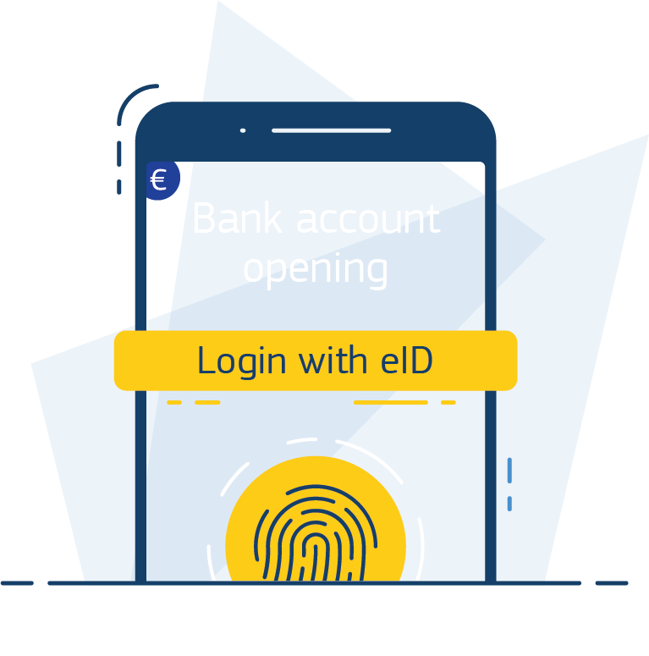
Is eID for me?
Yes, if you need to identify citizens from other Member States.
What we can help you achieve
Connect to the eIDAS network and offer services to citizens from other Member States
Have your national eID recognized in other countries
Become compliant with the eIDAS regulation
Increase the user base of
your services

Slide 37
Main Benefits
How do we support you?
1
Interoperability to ensure that other countries’ national eID schemes can be used to access your public services
1
Read our country overview to learn more about your Member State’s approach
2
Trust in the legal validity and status of online transactions across borders
2
Find your country’s Single Point of Contact
3
Security and low risk of identity theft by choosing a higher Level of Assurance (LoA)
3
Extensive documentation detailing how eID works and its benefits for Europeans
Notes:
Couldn’t fit nr. 4 Support through trainings, a dedicated service desk and online community.

Slide 38

Making Dutch public services accessible to European citizens with eID
The challenge
More and more Europeans are using electronic identification means to access public and private online services in their country. But what happens when someone travels to another European country?
Take the example from the beginning of this presentation, a Dutch municipality experiences that 20% of their service requests are made by EU residents. This high presence of non-Dutch residents created specific demands and strains on the administrative procedures. What if the non-Dutch but EU residents could use their nationally issued eID would ease the process?
The solution
eID helped this project to leverage the European eIDAS legal framework and interoperability infrastructure for cross-border recognition of eID, rather than building a new system from the ground up.
The Dutch municipality was convinced by eID because it is interoperable, ensured legal validity of transactions across borders and the same legal status as paper processes and ensures a lower risk of identity theft and misuse of personal information.
eID helps to electronically identify citizens, businesses and public authorities across Europe. eID supports the creation of the technical infrastructure and offer services to help public authorities get started in complying with the eIDAS regulation. This solution will enhance economic growth and sustainable development by ensuring access to both public and private online services across borders in an easy to access, secure and cost-effective manner for European citizens.
Read the story

Slide 39
Meet
eInvoicing
Send and receive electronic invoices in line with the European directive and standard

Slide 40
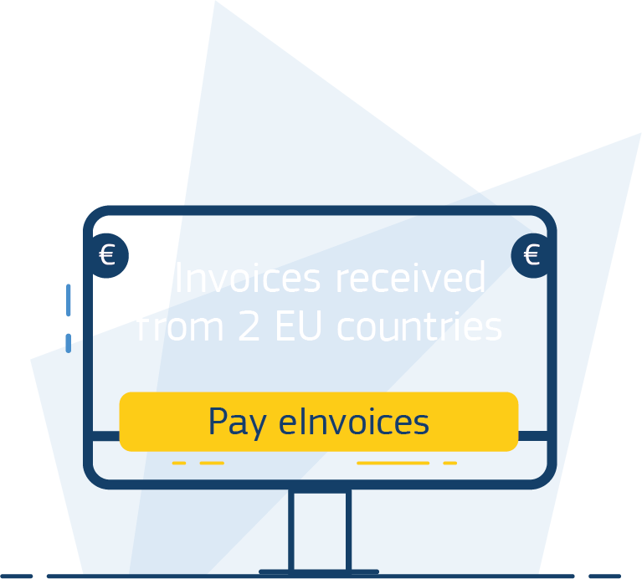
Is eInvoicing for me?
Yes, if you need to send or receive electronic invoices.
What we can help you achieve
Implement eInvoicing in public procurement
Implement the European Standard on eInvoicing
Be compliant with the eInvoicing Directive (2014/55/EU)
Ensure continuity of business (for public sector suppliers)
Notes:
Proposed 4th “what can we help you with” to fill in gap.

Slide 41
Main Benefits
How do we support you?
1
Support in the implementation of the eInvoicing Directive (2014/55/EU)
1
Tools and services to support in eInvoicing implementation
2
Reduced learning curve to implement B2G eInvoicing
2
Effective and ongoing support from the CEF Digital Team
3
Improved integration with other eProcurement processes
3
Knowledge base that provides insight, such as Member State statuses
Notes:
I left out 4th support: The possibility to apply for INEA funding to implement eInvoicing
Because none of the other BB’s have this option mentioned here. We’ll have a separate slide for INEA.

Slide 42

Connecting the private and public sector with eInvoicing
The challenge
Even though most invoices in Europe are in digital format today, they cannot be automatically processed and paid. Electronic invoicing aims to change this and transform the European invoice process to completely digital.
The solution
“ Less manual work, fewer errors, faster payments”, is the feedback from a Dutch energy provider that implemented eInvoicing for B2G and B2B payments. eInvoicing helped the private firm to improve administrative processes by reducing costs and time on administrative tasks.
eInvoicing supports the compliance with the eInvoicing Directive, enabling contracting authorities across Europe to receive and process electronic invoices according to the European standard on eInvoicing. eInvoicing is the foundation for EU-wide adoption of eInvoicing in public procurement.
eInvoicing is secure, safe and often cheaper than paper invoicing.
Read the story

Slide 43
Meet
eSignature
Create and verify electronic signatures in line with European standards

Slide 44
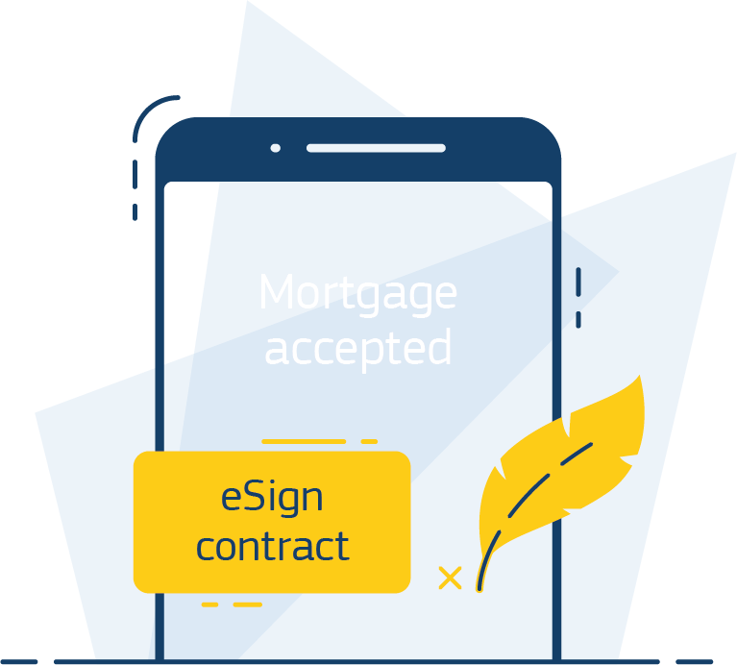
Is eSignature for me?
Yes, if you need to sign and ensure origin and integrity of your documents across borders.
What we can help you achieve
Transform paper-based procedures into secure and seamless electronic interactions
Benefit from the mutual recognition and cross-border interoperability of e-signatures
Enables interactions between businesses, citizens and public authorities
Sign and ensure origin and integrity of your documents in an easy way

Slide 45
Main Benefits
How do we support you?
1
A free service package with the open-source library DSS, or support in the use of EU Sign (for Commission agents and agencies)
1
Reduces time, costs and environmental impact by not having to print and send paper documents
2
Protects documents from duplication or alterations
2
A solution based on sustainable and secure European standards
3
Improved user experience thanks to fast response times and document processing
3
Support through our
service desk

Slide 46

Signing EU regulation with eSignature
The challenge
Businesses, citizens and authorities sign many documents by pen on paper, daily. This is time consuming, can lead to security breaches and in a digital age, there must be a better solution.
The European Commission introduced eSignature to improve the legislative signing process in 2017.
The solution
eSignature transforms paper-based procedures into a secure and seamless electronic interaction between businesses, citizens and public authorities.
eSignature helps to create and verify electronic signatures more efficiently and paper free. Like a handwritten signature in the offline world, an electronic signature is a legal concept capturing the signatory's intent to be bound by the terms of the signed document. The eSignature solution is compliant with the eIDAS Regulation, secure and most importantly, recognised all over Europe.
Read the story

Slide 47
Meet
eTranslation
Enable multilingual public services and communication

Slide 48
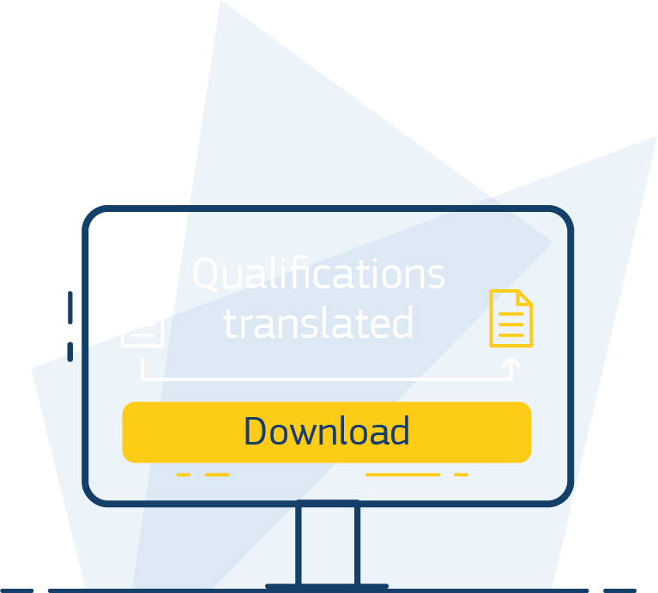
Is eTranslation for me?
Yes, if you need to communicate in different languages.
What we can help you achieve
Integrate eTranslation directly into your digital services (public sector organisations)
Translations to and from any of the 24 EU official languages, Icelandic and Norwegian
Request machine translations for text snippets or documents on demand (for officials)
Translating documents in various formats (doc, pdf, odt, xlsx, html etc.)

Slide 49
Main Benefits
How do we support you?
1
High quality machine translations drawing on decades worth of work by EU translators
1
eTranslation web service to use for on demand translations or to integrate into your digital platform
2
Intellectual Property Rights of the translation remain with the owner of the original text
2
A dedicated service desk to support you in the integration
3
The European Language Resource Coordination (ELRC) network identifies and gathers language resources to improve translation quality
3
Fast translation into multiple languages at once
Notes:
Benefit 4 didn’t fit and none of the other BB’s mention funding either: CEF grants are available to support cross-border implementation.

Slide 50

Connecting Member States with eTranslation
The challenge
Many member states share their borders with fellow member states. Close proximity often translates into close cross-border trade. However, many obstacles lie in the way of cross-border cooperation. One is a language barrier.
Take the example of Croatia, Slovakia and Slovenia, three countries in central Europe, and their attempt to open their national eProcurement process across borders. With eProcurement, the management of public tenders was set to be simplified to shorten the bidding cycle, increase transparency and boost innovation.
Yet, the member states needed to ensure that the platform and tenders seamlessly translate into Croatian, Slovak and Slovene.
The solution
TendersForAll, the platform interconnecting the three countries procurement systems, integrated with eTranslation to translate all the tendering information for potential suppliers in their language. This breaks down language barriers and increases cross-border procurement for the three countries.
eTranslation breaks down language barriers by offering machine translation tool to public authorities. The service covers all EU languages, as well as Icelandic and Norwegian, by translating digital text on demand and by automatically populating multilingual digital content and services. eTranslation services enhance process efficiencies and reduce costs.
High quality machine translation draws on decades worth of work by EU translators, offering excellent results for EU policy and legal documents. It is confidential, secure and simplifies translation processes by providing fast translation into multiple languages at once.
Read the story

Slide 51

Ready to get started?
Reach out to us to learn more!
Or visit our website www.ec.europa.eu/cefdigital

